Slide 1
Trouble free tracker

Slide 2
Problems in OT
To know the number of patients waiting for surgery
Miscommunications between staff
Tracking patients posted for surgery
Explaining attender’s about status of their patient

Slide 3
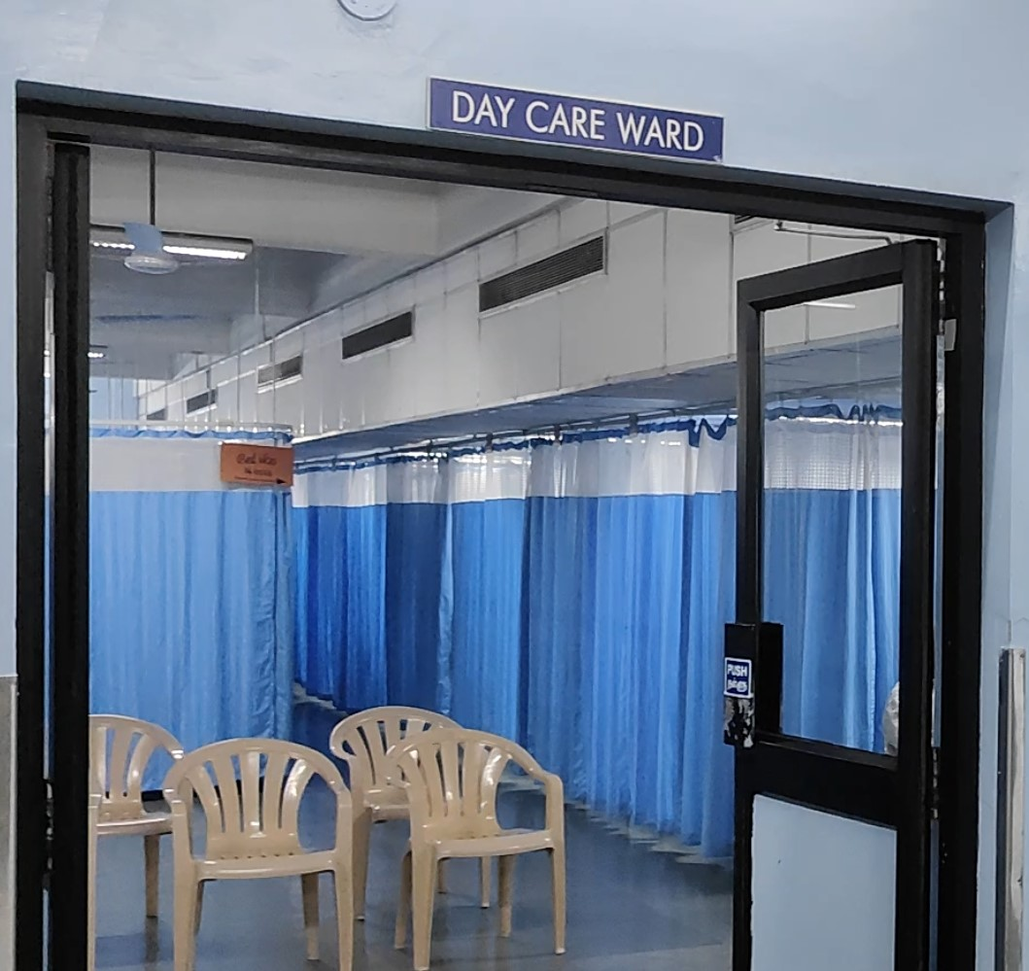
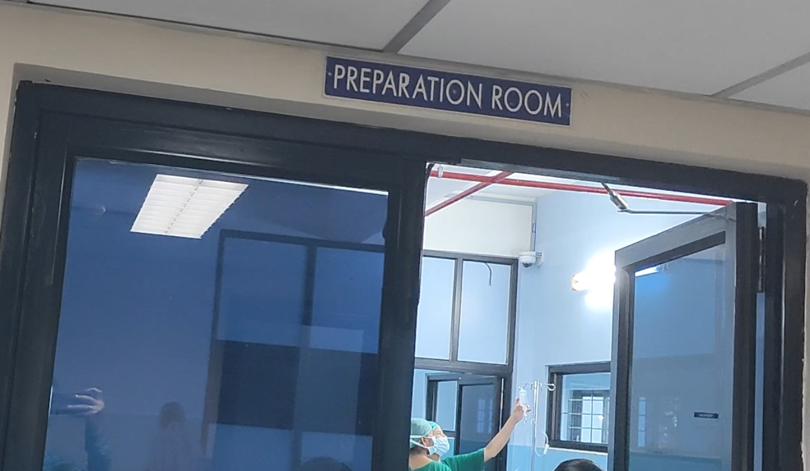
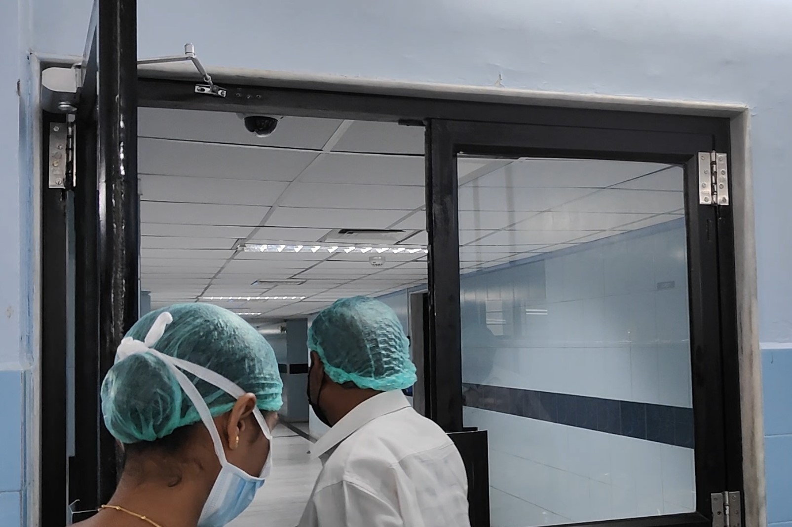
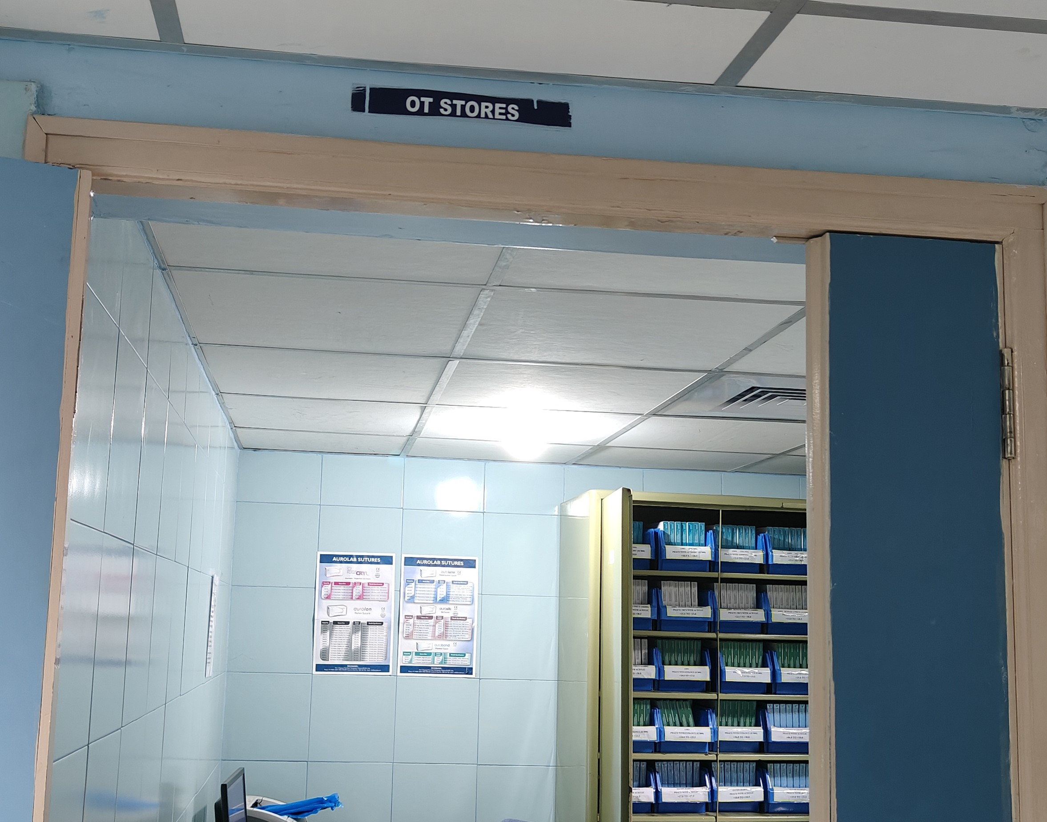
Preparation room
Day care ward
Recovery room
Operation theatre

Slide 4
Objectives
To increase OT efficiency
To increase Patient satisfaction
Alleviate attender’s anxiety
To improve communication between staff
To improve overall quality management
Simple and cost effective

Slide 5
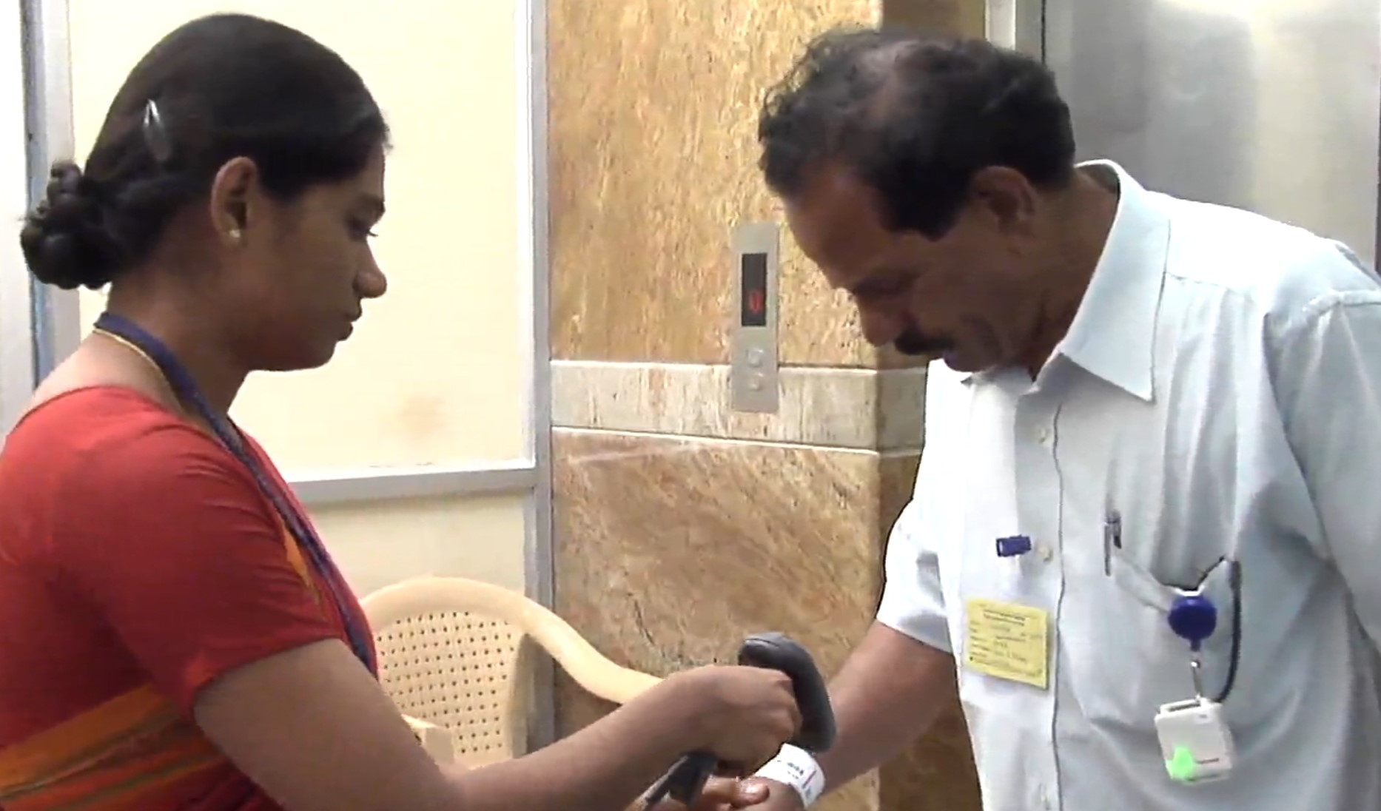
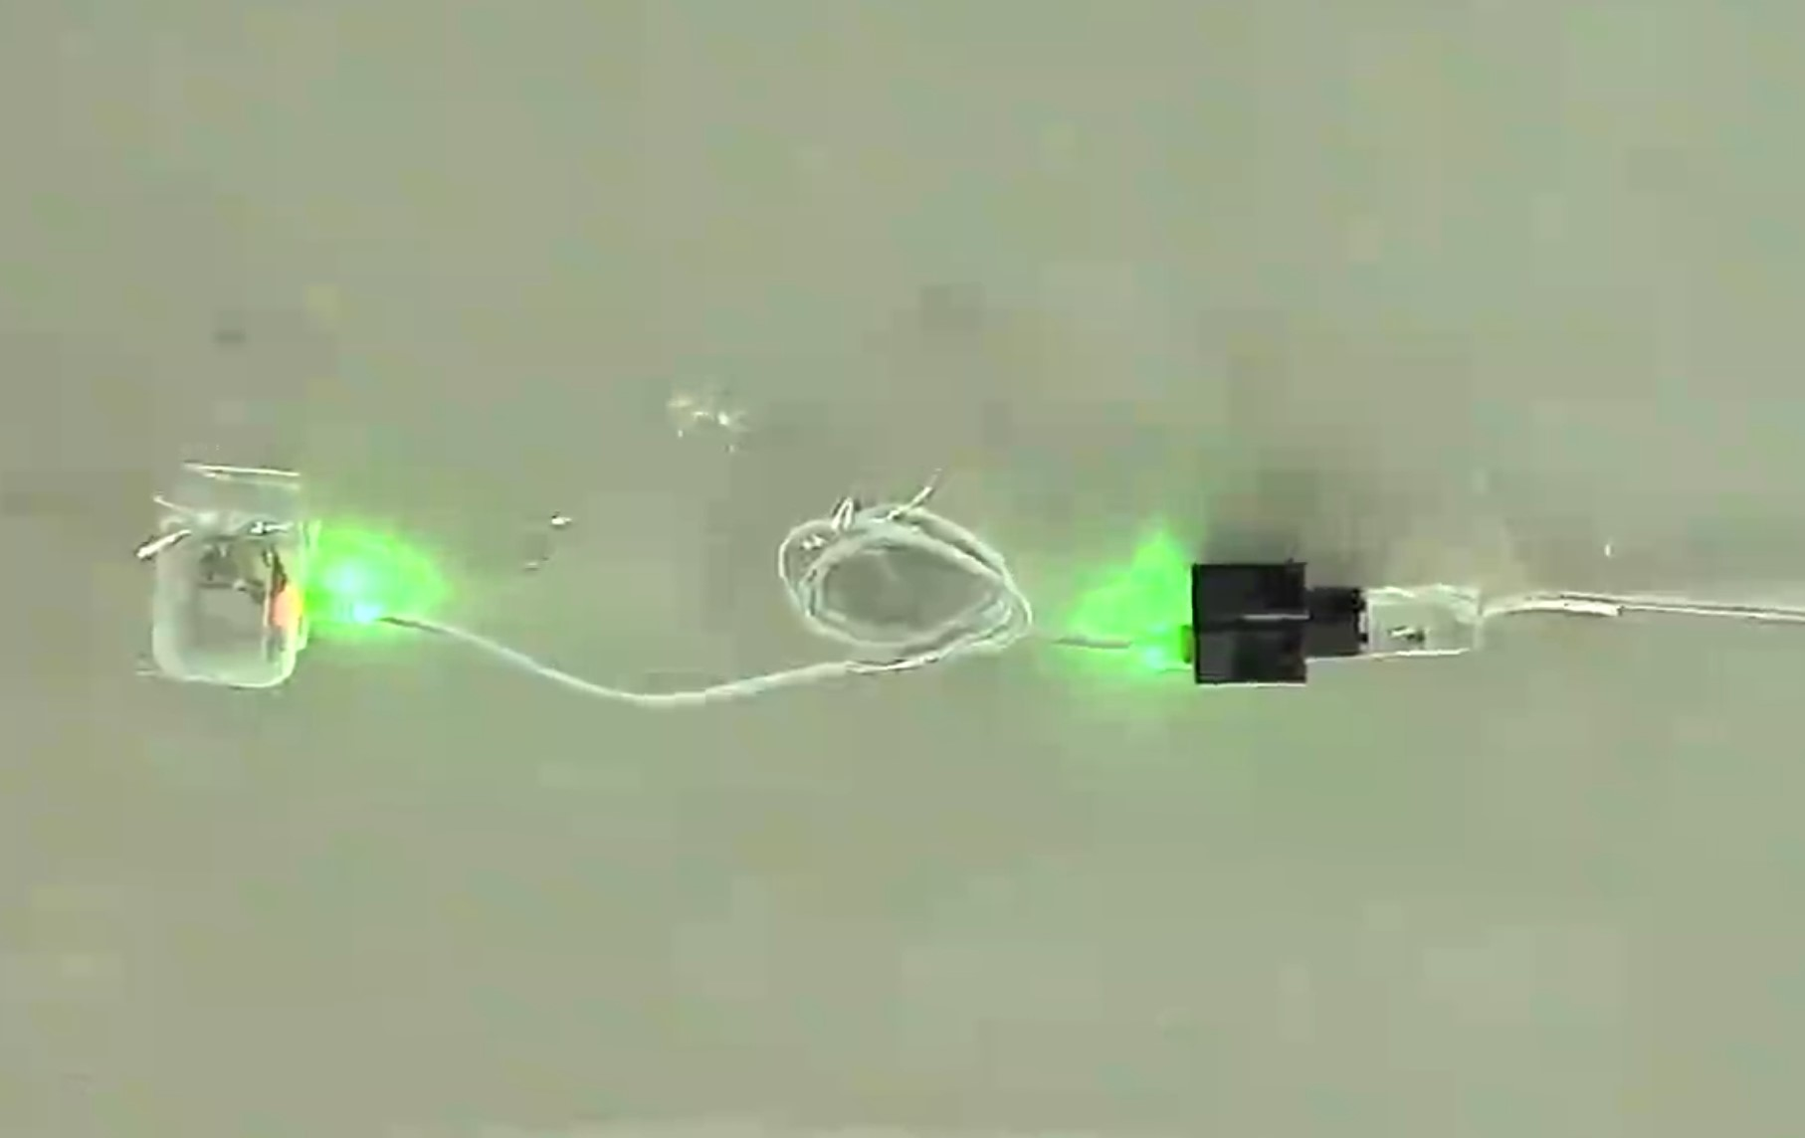
Existing solution
Individual RFID scanning
Limitations
Active RFID tags needs recharge at frequent intervals
Installation and Management of RFID Tags and readers are not cost effective

Slide 6
Proposed Solutions
Using a Manual barcode scanner at each station
Automatic barcode scanner at the entrance of each station
Implementing AI driven tracking software to automate and make the process more efficient and hassle free

Slide 7
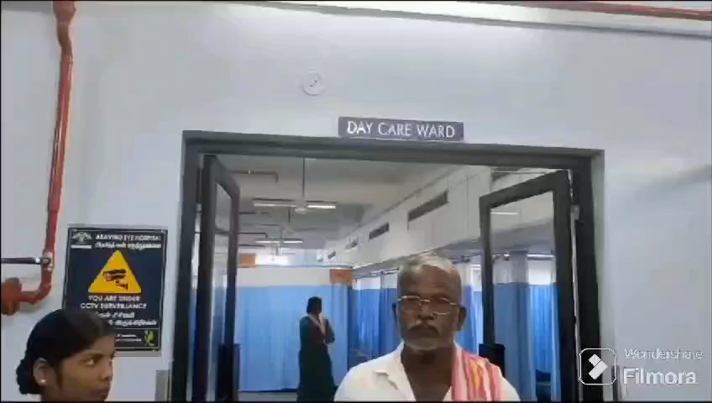

Slide 8
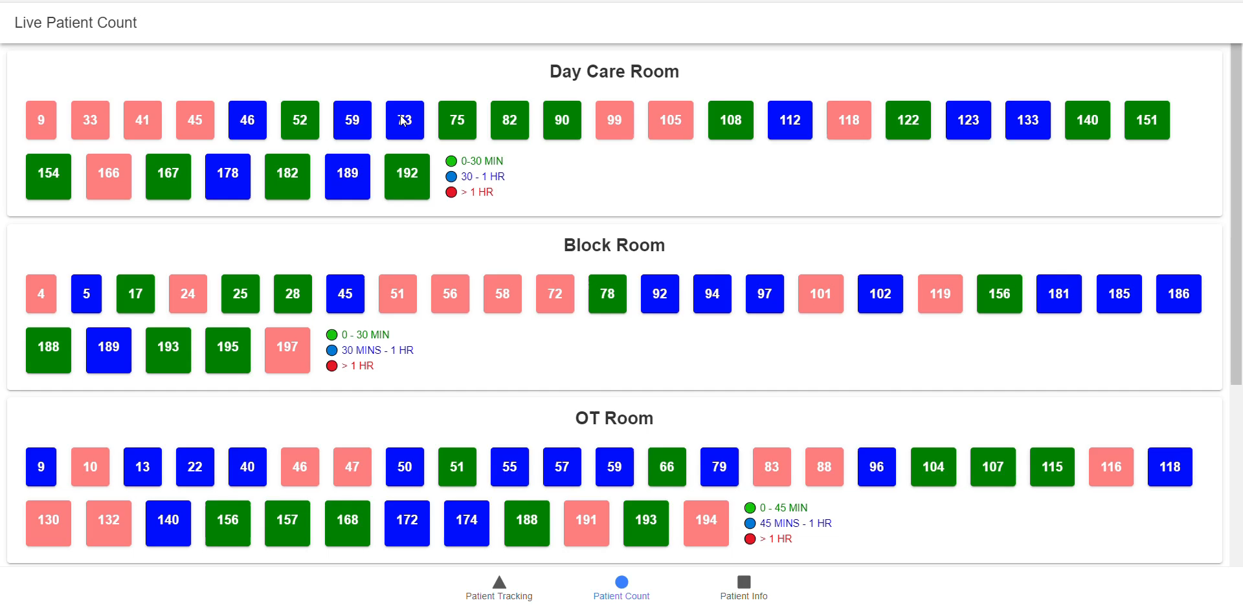

Slide 9
Future Enhancements Leveraging AI and OpenCV
Implementing AI and OpenCV driven patient detection in CCTV cameras for patient tracking.
It enables real-time active tracking and enhances the efficiency of the tracking.
The system can be programmed to detect falls, especially in areas like recover room, triggering immediate assistance and reducing response times.
It can provide alerts when a patient moves outside designated areas, reducing the risk of patients getting lost or entering restricted zones.

Slide 10
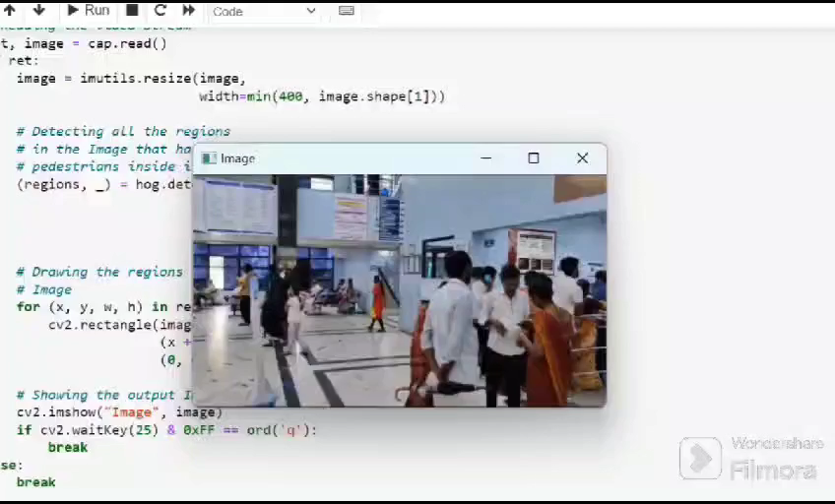
Thank you
Future Enhancements Leveraging AI

Slide 11
THANK YOU

